Slide 1
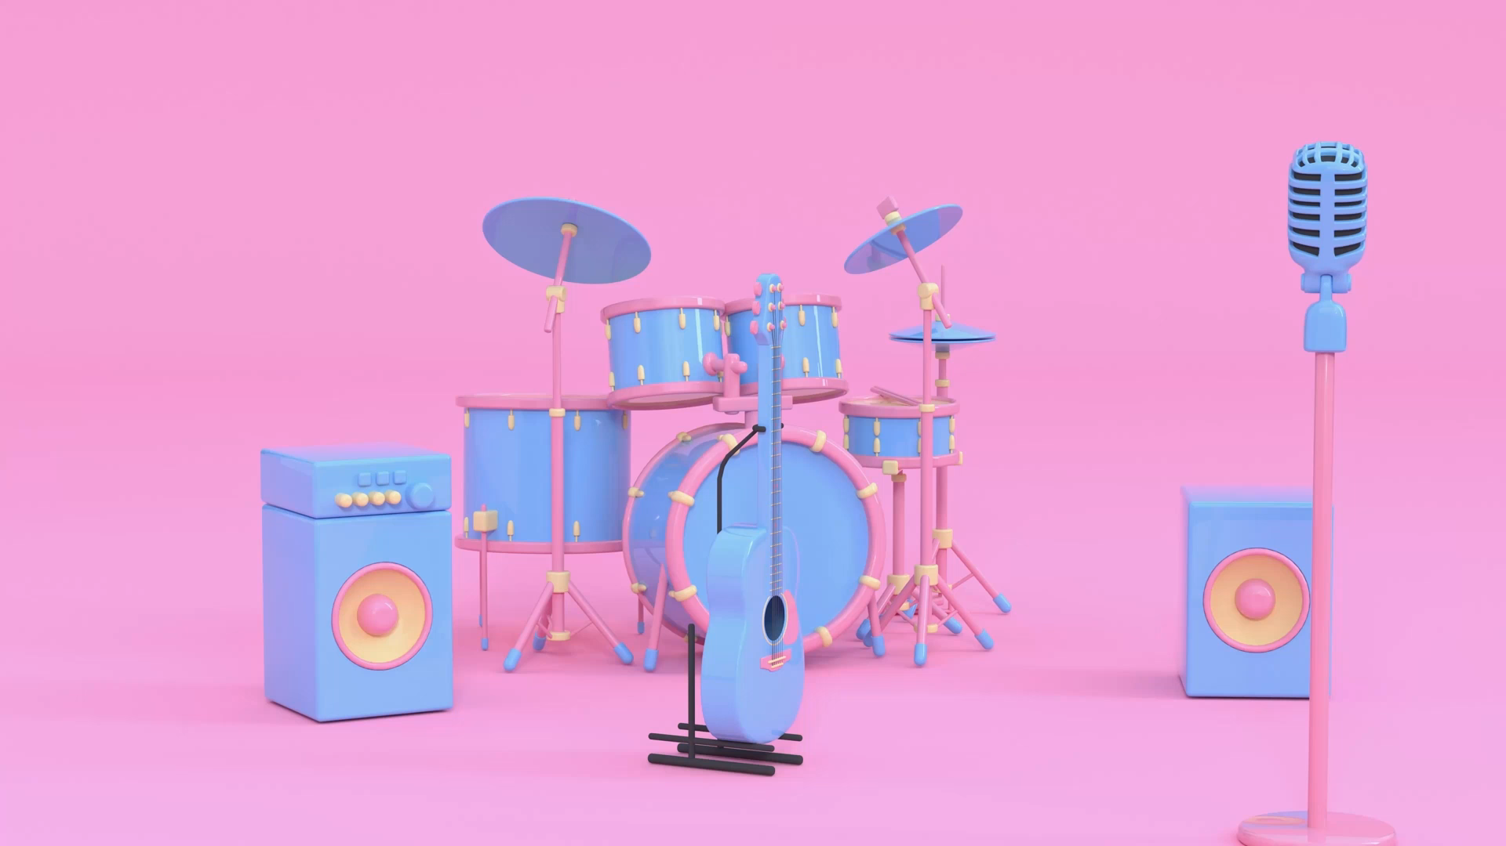

Music Recommendation System- Content Based
Group- 1

Slide 2
Team Member
Mentor
Ms. .Neha
Date:23-02-2022
Farhat Imam
Rupesh M
Shreyas Shrinivas
Shreesh Shrinivas
S K Mohammad Akhleem Nawaz
Khan Osama Shamim
Jagdish Nirwani

Slide 3
Project Workflow
Data Set
Preprocessing the data set(EDA)
Model Building
Deployment

Slide 4
What is Recommendation System Recommender systems are the systems that are designed to recommend things to the user based on many different factors. These systems predict the most likely product that the users are most likely to purchase and are of interest to. Companies like NETFLIX, Amazon, etc. use recommender systems to help their users to identify the correct product or movies for them.

Slide 5
Why the Recommendation system?
Benefits users in finding items of their interest.
Help item providers in delivering their items to the right user.
Identity products that are most relevant to users.
Personalized content.
Help websites to improve user engagement.

Slide 6
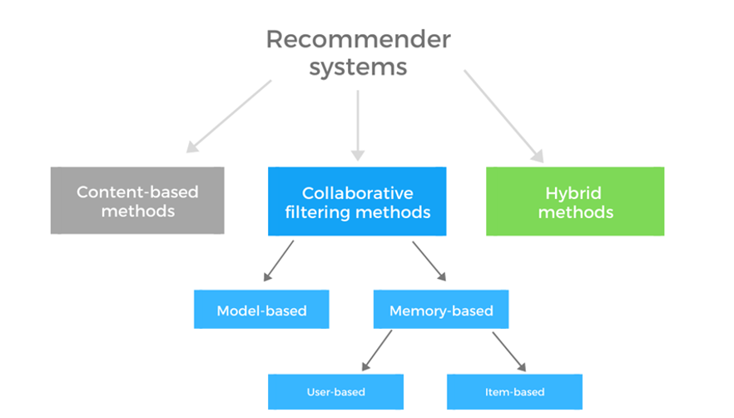
Types of Recommendation System

Slide 7
Content-based Filtering
The second most popular recommendation system, content-based filtering takes items bought as input data to recommend similar items. Recommendations are specific to every user under content-based filtering, therefore, can scale to a large user base. Such recommendations are often found across eCommerce portals, video streaming apps, and digital libraries under the “Similar products” or “Recommended items” tags.

Slide 8
Project Motive
Music Based Recommendation System is based on the relaxing and Mediation Songs. We are Building a recommendation System Where user can get a recommendation of based on tags or similar music search or user history. Which will given user to get a glance of similar song which he/she is interested

Slide 9

Final OutPut

Slide 10
Thank You

